Slide 1
Real Time Systems

Slide 2

Motivation for RTS
First shuttle flight delayed due to overload during initialization
Timing bug
Simple solution to timing constraints = faster hardware??
Hidden delays and limits of speedup
Common resources – deadlocks
Functional complexity
Smart phones
Windows+bloatware+antivirus
http://en.wikipedia.org/wiki/STS-1

Slide 3
Real-Time Processing
Correctness of the system
Logical – functional correctness of response
Temporal –response completed before deadline
Traditional approach – static scheduling
Modern approaches
Dynamic scheduling and resource management
Online guarantee
Extended lifetime

Slide 4
What is Real Time?
An application that requires a guaranteed response within a strict timing constraints
A system that would react at the same moment as the trigger occurs
real time" really just means a system where tasks have to be completed by deadlines.

Slide 5
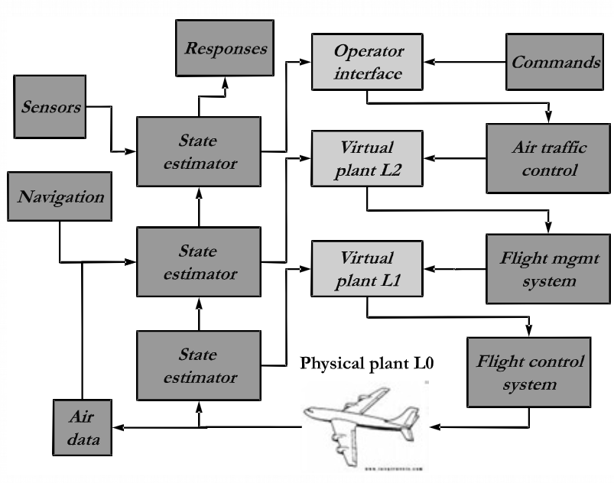
RT Applications: Controllers

Slide 6
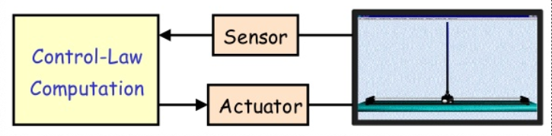
Digital Control Systems:
Periodically performs the following job
Senses the system status and actuates the system according to current status

Slide 7
RT Applications: Signal Processing
Radar system
Distributed sensors
Processing complexity
Multimedia
1080p format – how many pixels?
Computation often increases O(n^2), O(n^3),
O(e^n)
CCTV vs dynamic movie vs sport event timing

Slide 8
RT Application Types
Purely cyclical
Often forced by fixed pooling for event (sensing)
Jobs and events are harmonized
Mostly cyclical
Some jobs – event detection may be non-periodic (e.g. interrupt signal)
Asynchronous and predictable
Random events but with bounded intervals and rates
Asynchronous and unpredictable

Slide 9
Characteristics of RTS
Guarantee individual timing requirements of each task
Predictability of time delay
Guarantee completion of critical tasks
Smooth movie playing
Long lifetime
Mars rover, Voyagers
Nuclear plant

Slide 10
Soft Vs Hard RT
Hard Real-Time – If the event is not processed in a strict timing window then bad things will happen
Soft Real-Time – If the event is not processed in a not as strict timing window then the system may degrade but its not as bad

Slide 11
Hard Real Time
Hard deadline – when missing it may result in fatal fault
Nuclear reactor
Air bags in car
Tardiness – the difference between completion time and deadline
“Margin of error” in time domain
Reliability and recovery
Difficult to guarantee with 100% probability

Slide 12
Soft Real Time
Timely execution by deadline not only constraint
Performance
Development and validation rigor
Depends on application
80ms delay in voice is acceptable for RT telephony
Dropping 1% of video frames is acceptable in MPEG
Soft: guarantee of quality-of-service, validation of requirements, timing constraints

Slide 13

Hard Real Time Example

Slide 14

Hard Real Time Application Gone Wrong!!

Slide 15
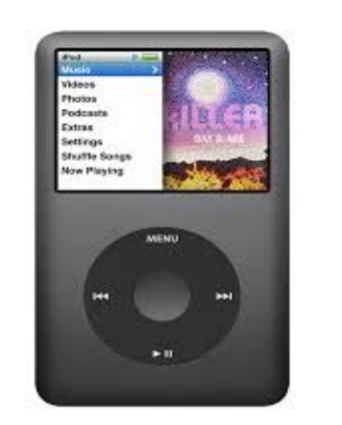
Soft Real Time Example
Multimedia application:
Performs the following job periodically
Reads, decompress, and displays audio video streams periodically

Slide 16
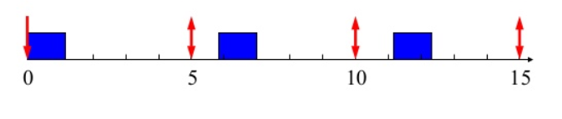
Real-Time Metrics
Interrupt Latency – Time to process an interrupt
Scheduling Latency – Time for the OS Scheduler to start a processing task (Nominal and Worst-case)
Job- Each unit of work that is scheduled and executed by the system
Processor/server-resource required to execute job
Task- A set of related jobs. E.g. cruse control loop with jobs: measure speed, validate data, calculate required acceleration, apply throttle

Slide 17
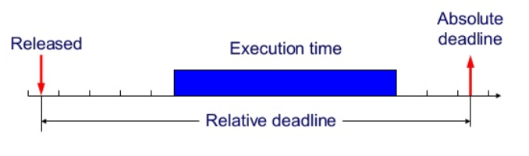
Real-Time Metrics
Release time- Time instant at which a job becomes available for execution
It can be executed at any time at or after the release time
Deadline- Time instant by which a job should be finished
Execution time- Time to complete job
Laxity: of a job that may be soft/hard.
Preemption: Current job intervention by a higher priority job

Slide 18
Real-Time Metrics
Periodic task T
Worst case execution time,e
Job J
Response time = finish time – release time
Deadline miss if
Finish time > absolute deadline
Response time of J> D

Slide 19
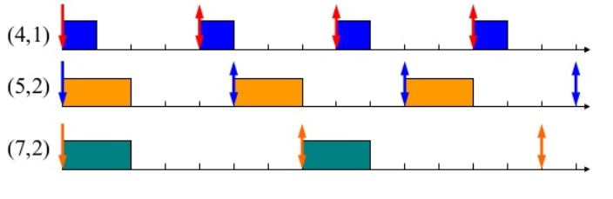
Schedulability
Property indicating whether a real time system ( or set of tasks) can meet their deadlines.
Two Types:
Static Scheduling
Dynamic Scheduling

Slide 20
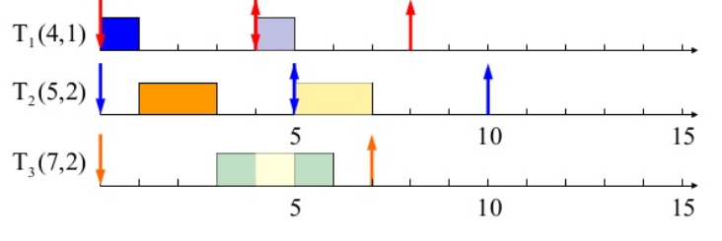
Static Scheduling: Rate Monotonic
Optimal Static Priority Scheduling
Priorities are fixed along the course of all tasks’ execution
Assigns priority according to task period
A task with a shorter period has higher priority
Executes a job with shortest period first
Task (period, execution time)
T3 preempted by higher priority task T1

Slide 21
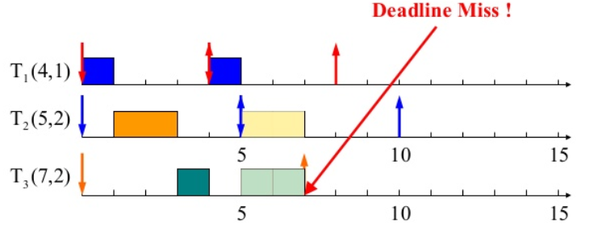
Deadline miss for task, T3, so these tasks are not schedulable by Rate Monotonic scheme
Note: deadline= release time + period. T3’s first job’s deadline was 5 (0+7=7) but the execution finished at 8 due to preemption from T1 and T2.

Slide 22
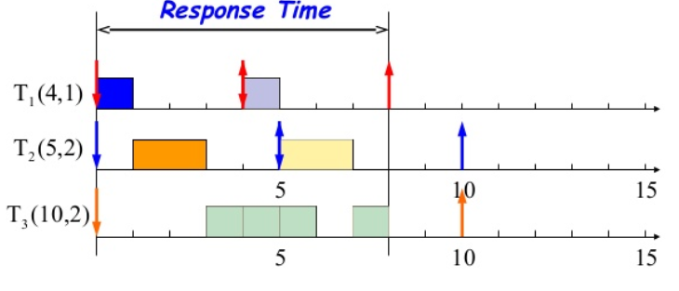
Response Time
Duration from release time to finish time is called Response Time

Slide 23
Dynamic Scheduling: Earliest Deadline First (EDF)
Optimal dynamic priority scheduling
A task with a shorted deadline has higher priority
Executes a job with earliest deadline

Slide 24
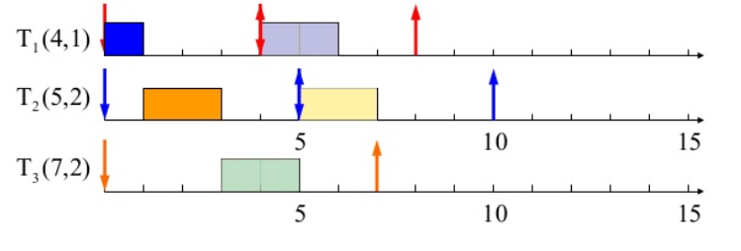
EDF EXAMPLE (1)
Execute job with earliest deadline first
Note: deadline= release time + period.
Task (period, execution time)

Slide 25
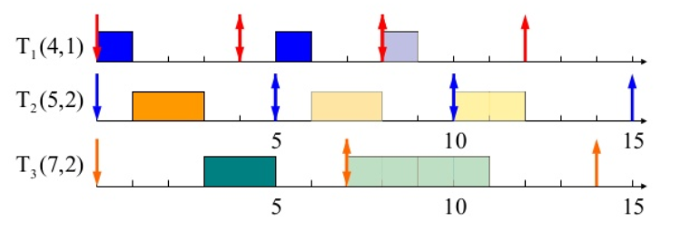
EDF EXAMPLE (2)
Execute job with earliest deadline first
Note: deadline= release time + period.

Slide 26
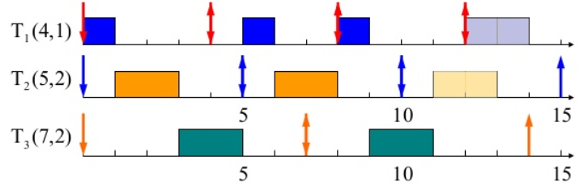
EDF EXAMPLE (3)
Execute job with earliest deadline first
Note: deadline= release time + period.

Slide 27
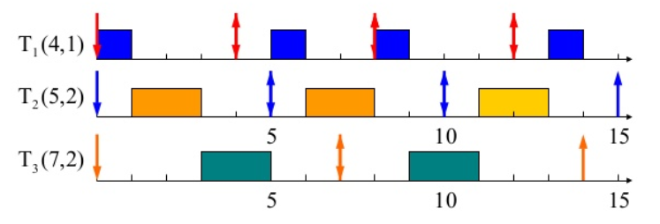
EDF EXAMPLE (4)
Execute job with earliest deadline first
Note: deadline= release time + period.

Slide 28
RM Vs. EDF
RM: Simpler implementation, predictability for higher priority tasks
EDF: Full processor utilization, misbehavior during overload conditions

Slide 29
Can RPi be used for Real Time Scheduling
Current Linux kernels for the Raspberry Pi do not support real-time –
Standard Linux or BSD install includes services that generate lots of overhead
No Real-Time Clock
– Expects device to be always connected to the internet
– Cannot generate deterministic timing pulses to control things like DC motors
- Does not guarantee perfect timing accuracy with internet

Slide 30
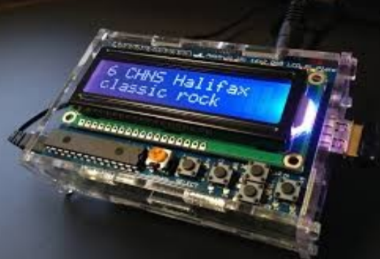
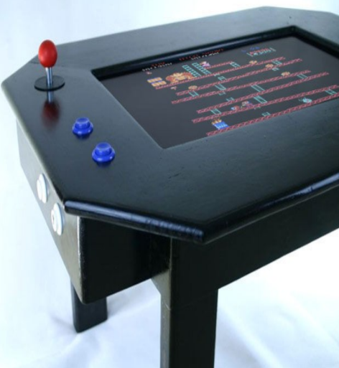
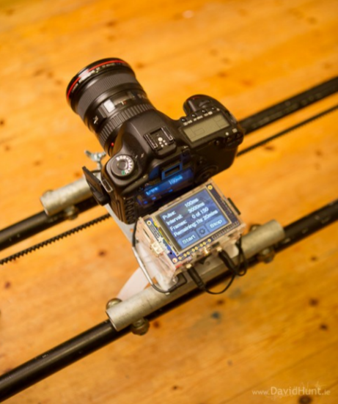
Real Time Projects Using Raspberry Pi

Slide 31
Simulating a Customized Real Time Scheduler on Raspberry Pi
Design a set of tasks and their jobs
Specify timing constraints
Schedule task execution using both the scheduling policies
Conduct timing performance analysis
Implementation hint: Using interrupt service routines, Timers, Threads, serial communication modes such as UART
(the UART baudrate can be used in determining the timing to compare it other data transfer techniques like DMA )
May use a continuous counter that serves as a clock

Slide 32
Design a set of tasks and their jobs
Task-1 (ADC) | Task-2 (GPIO) | Task-3 (UART_Help) | Task-4 (GPIO LED)
J1 - UART receive ‘T’ or ‘t’ | J1: Read GPIO Push button | J1 - UART receive ‘H’ or ‘h’ | Task 4 – Default Task: J1: Blink LED
J2 - Read ADC (temperature sensor) | J2: Transmit Message (m1= “Push Button Triggered!”) on LCD/ console | J2 - UART Transmit Message (msg_help = “This code monitors for blue/user button trigger, and reads ADC1 when asked with letter 't'”)
J3 - UART Transmit ADC output

Slide 33
Specify timing constraints
Tasks/Jobs | Deadline Di | Priority Pt | Execution time (Ei) | Laxity (Soft/Hard) | Period Pi
T1/J1 T1/J2 T1/J3 | 3 ms | 2 | 0.1 ms | Soft | Aperiodic
 | - |  | 48 us | -
 | 5 ms |  | 0.2 ms | Soft
T2/ J1 T2/ J2 | - | 3 | 1000 ms | -
 | 5 ms |  | 1.1 ms | Soft
T3/J1 T3/J2 | - | 4 | 0.1 ms | -
 | 10 ms |  | 9.1 ms | Soft
T4/J1 | 2000 ms | 1 | 1000 ms | Soft | Periodic

Slide 34
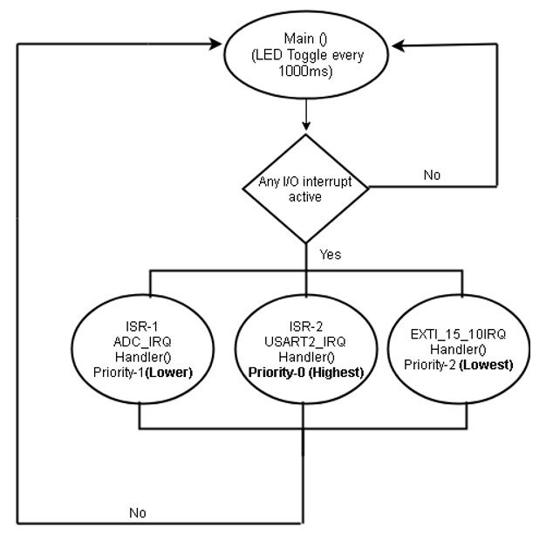
Default Task (T4): LED toggle in the background every 1s
Tasks, T1-T3, implemented using ISR.
Tasks priority is set by the user depending on static-priority policy or dynamic priority policy

Slide 35
Performance analysis
Timing analysis for
RM Vs. EDF
Interrupts Vs. Polling
Memory/RAM usage:
Interrupts Vs. Polling
Check which tasks are schedulable (or not) using RM and EDF.
Whether all the tasks meet their deadlines for the longest course
Which scheduling policy (RM Vs. EDF) fails first
Improvements?

Slide 36
Particle Photon Real Time Scheduler
https://community.particle.io/t/getting-timers-to-work/26904
https://community.particle.io/t/delay-vs-timer-vs-millis-solved/42646
https://community.particle.io/t/timealarms-scheduler/4046
https://www.youtube.com/watch?v=784uyX4nXRI
https://community.particle.io/t/scheduling-a-function-on-photon/18815
https://www.youtube.com/watch?v=ai1AnVyZSFM

Slide 37
References
https://www.socallinuxexpo.org/sites/default/files/presentations/Steven_Doran_SCALE_13x.pdf
https://www.iot-programmer.com/index.php/books/22-raspberry-pi-and-the-iot-in-c/chapters-raspberry-pi-and-the-iot-in-c/33-raspberry-pi-iot-in-c-almost-realtime-linux?start=1
https://www.cse.unr.edu/~fredh/papers/thesis/075-delaney/thesis.pdf
https://link.springer.com/chapter/10.1007/978-981-13-1217-5_13
https://ethertubes.com/raspberry-pi-rts-cts-flow-control/
https://www.cse.wustl.edu/~lu/cse467s/slides/scheduling.pdf1
http://beru.univ-brest.fr/~singhoff/cheddar/publications/audsley95.pdf

